Slide 1
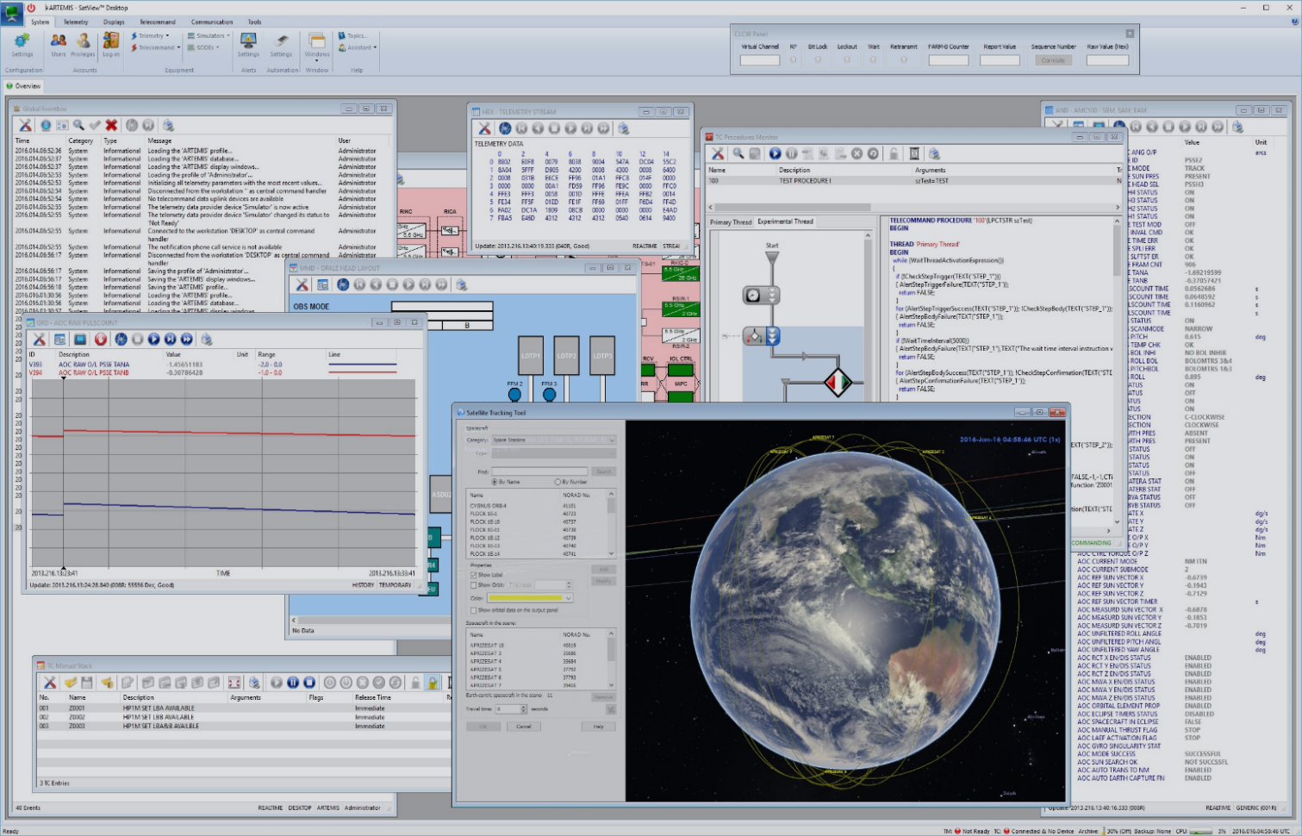
Satview Desktop
SatView (specifically the hARTEMIS SatView Desktop) is an advanced, all-in-one Satellite Monitoring and Control System used by aerospace engineers—including those at the European Space Agency (ESA)—for real-time mission operations. Designed as a comprehensive "mission control in a box," it integrates everything an operator needs into a single environment: 3D orbital tracking, live telemetry data streams, system health graphs, and telecommand scripting. The user experience is highly technical and data-dense, requiring operators to manage multiple floating windows simultaneously. While the interface might look overwhelming to an outsider, this customizable layout is intentionally built for operational efficiency; it ensures that engineers can instantly correlate raw spacecraft data with visual location tracking and execute critical commands without ever having to switch to a different software program.
Key Capabilities:
Orbital Tracking: Real-time 3D visualization of satellite trajectories and positions around Earth. Orbital Tracking: Real-time 3D visualization of satellite trajectories and positions around Earth. Orbital Tracking: Real-time 3D visualization of satellite trajectories and positions around Earth.
Telemetry Monitoring: In-depth tracking of spacecraft health, displaying raw hex streams, live parameter lists, and graphical data trends.
Telecommand Management: Tools for scripting, queuing, and executing commands (TCs) sent to the spacecraft.
System Logging: A global event log tracking all system activities, connections, and automated processes.

Slide 2
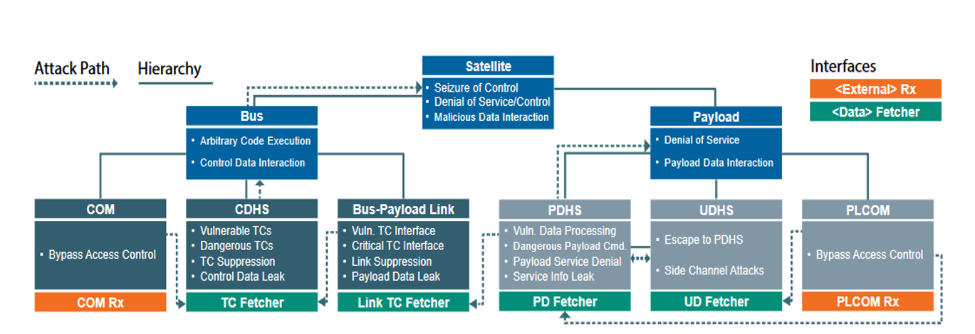
eForensics Vol.12
Satellite Attack Path Hierarchy No.01
Threat taxonomy (or threat model) for satellite firmware, mapping out how cyberattacks can target different internal systems of a satellite.

Slide 3
Satellite Attack Path Hierarchy Explained
<External> Rx
External Rx (Orange Boxes): These represent the physical external receivers (like antennas) on the outside of the satellite. They receive radio frequencies from Earth. An attacker's first step is often beaming a malicious signal here.
The Entry point of an attack
Satellite: The Top Level
Seizure of Control: Taking complete, unauthorized command of the entire satellite and its flight path.
Denial of Service/Control: Permanently locking out ground operators or completely disabling the satellite so it becomes space junk.
Malicious Data Interaction: Tampering with the satellite's core functions or faking the primary mission data it sends back to Earth.
<Data> Fetcher
Bus
Data Fetcher (Green Boxes): These are the internal software or hardware buffers that pull the data from the receivers into the satellite's internal systems. They act as the doorways from the outside in.
Arbitrary Code Execution: Running unauthorized, malicious software directly on the satellite's core flight computer to hijack its systems.
Control Data Interaction: Tampering with the critical data that manages the satellite's physical survival, such as its navigation, power, or thermal controls.
Payload
Payload: The mission equipment (like cameras, GPS, or scientific sensors). Attacks here focus on ruining the mission by disabling the instruments or corrupting the data they collect.
COM
CDHS
Bus-Payload link
PDHS
UDHS
PLCOM
COM (Communications): The main radio link to ground control. Attackers target this to bypass security checks and sneak into the system by spoofing a legitimate connection
CDHS (Command & Data Handling System): The satellite's "brain." Hackers target it to inject malicious commands, block Earth signals, or steal flight data.
Bus-Payload Link: The internal network bridge connecting the vehicle's brain to the mission instruments. Hackers exploit this to "jump" from a compromised Bus over to the Payload.
PDHS (Payload Data Handling System): Processes the primary mission data (like compressing spy photos). Vulnerabilities here allow attackers to physically damage the sensors or leak sensitive mission intel.
UDHS (User Data Handling System): Manages secondary or lower-security user data. Hackers often use this less secure area as entry to break out and invade the main Payload (PDHS).
PLCOM (Payload Communications): A dedicated, high-speed radio link used to beam large mission files back to Earth. Hackers try to bypass its access controls to intercept or disrupt the data download
Bypass Access Control (Between COM Rx & COM): This is the act of sneaking past the satellite's "front door" security. After the antenna (COM Rx) picks up a malicious radio signal from Earth, the attacker must trick, defeat, or bypass the satellite's authentication checks (like encryption or passwords) to successfully break into the main Communications (COM) system
Vulnerable TCs: Sending crafted commands to crash or disrupt the satellite.
Dangerous TCs: Using valid commands to cause harmful actions.
TC Suppression: Blocking ground commands to cut off control.
Control Data Leak: Stealing sensitive onboard data
Vuln. TC Interface: Exploiting weak internal links to move from the bus to the payload.
Critical TC Interface: Breaching sensitive pathways to send harmful commands to instruments.
Link Suppression: Blocking internal communication between bus and payload.
Payload Data Leak: Intercepting mission data as it moves between systems.
Vuln. Data Processing: Exploiting bugs in data handling to crash the system.
Dangerous Payload Cmd.: Using valid commands to physically harm the payload.
Payload Service Denial: Shutting down or jamming the instruments.
Service Info Leak: Stealing sensitive mission or instrument data.
Bypass Access Control (Between COM Rx & COM): This is the act of sneaking past the satellite's "front door" security. After the antenna (COM Rx) picks up a malicious radio signal from Earth, the attacker must trick, defeat, or bypass the satellite's authentication checks (like encryption or passwords) to successfully break into the main Communications (COM) system
Bypass Access Control
COM rx
TC Fetcher
Link TC Fetcher
PD Fetcher
UD Fetcher
PLCOM rx
External Rx (COM Rx, PLCOM Rx): The physical antennas on the outside of the satellite. This is the very first entry point where a hacker beams a malicious radio signal from Earth.
Data Fetcher (TC Fetcher, PD Fetcher, etc.): Internal software or hardware gateways. They act as doorways that pull the malicious data from the outside antennas directly into the satellite's internal computers
The internal gateway that forwards commands to instruments; attackers can exploit it to move between systems.
The internal gateway that pulls commands and data into the main payload system. Hackers exploit this to feed malicious instructions directly to the mission instruments.“
UD Fetcher (User Data Fetcher): The internal gateway that imports secondary user data; due to its lower security level, it is often targeted as an initial entry point into the payload system.
External Rx (COM Rx, PLCOM Rx): The physical antennas on the outside of the satellite. This is the very first entry point where a hacker beams a malicious radio signal from Earth.

